Slide 1

Research Report Update
Jaden Yuen, Frank Chiu, Jasmine Oh

Slide 2
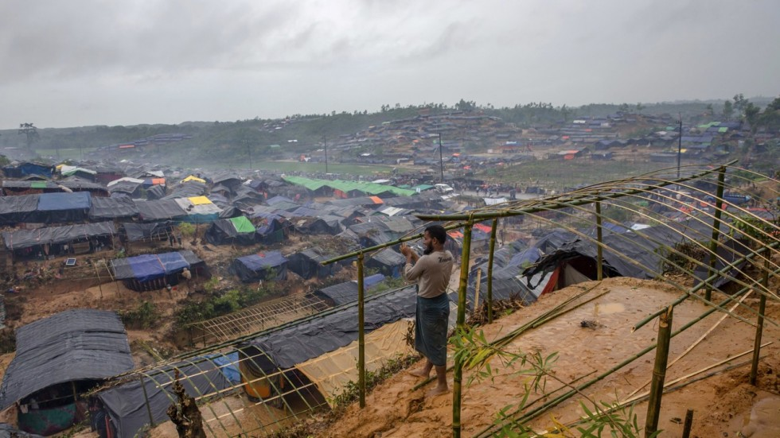
Human Rights violations and abuses
Against Rohingya Muslims and other minorities in Myanmar

Slide 3
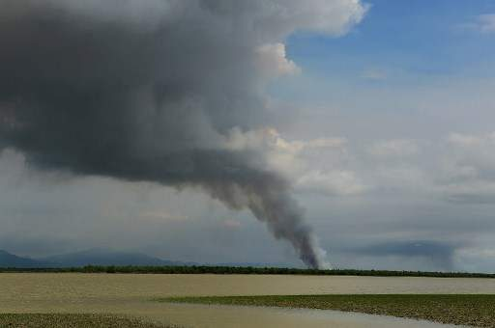
Current Events Update
Rakhine migrants are moving into vacated land previously inhabited by Rohingya Muslims that were abandoned after military assault. They claim to be seeking a “Rohingya-free buffer zone”.
Of a list of 8,000 Rohingya refugees seeking return to Myanmar, the Myanmar government was only willing to take back less than 400.

Slide 4

Current Events 2
A UN Human Rights team asserts and blames the use of Facebook as a form of social media that had a “determining role” spreading hatred of Rohingya in Myanmar.

Slide 5

Positions: Aung San Suu Kyi
The controversial leader and Nobel Peace Prize Laureate in Myanmar, Aung San Suu Kyi, had recently emerged from her political silence after the “genocide” of Rohingya Muslims and announced her intent to attend the next ASEAN summit on March 17, 2018.

Slide 6
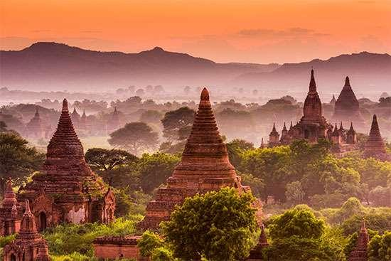
Positions: Myanmar
Land grabs - In recent reports, the Myanmar government has been claiming land from which Rohingya villagers had vacated. In its place, Myanmar began construction of military bases as well as the integration of Rakhine migrants into the region.
Government spokesman continues to deny any crimes committed towards the Rohingya, dismissing satellite images of bulldozing as “clearing land to make it suitable for rebuilding for the refugees”
The government continues its censorship of information, and recently arrested two Reuter reporters under the government’s “Official Secrets Law”

Slide 7
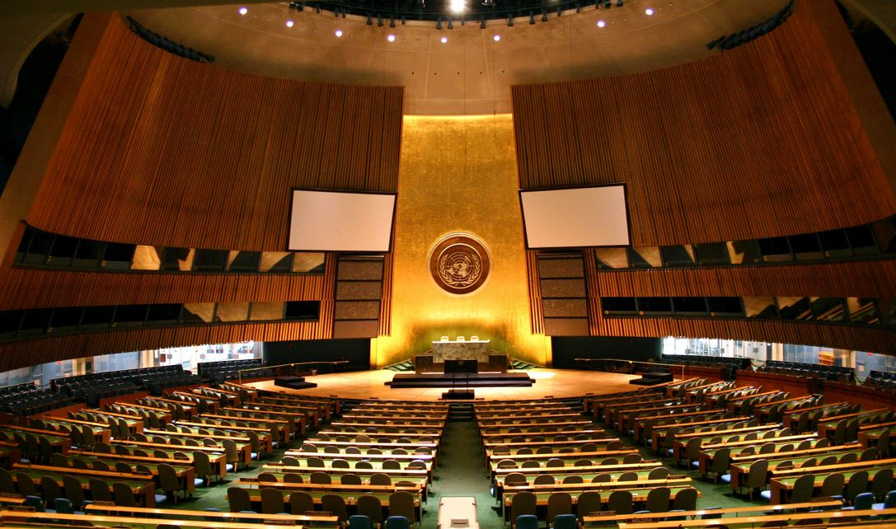
Positions: Organizations
United Nations - Attempting to rally 1 billion dollars in funds to address the Rohingya refugee crisis, yet continues to face troubles.
Heavily condemned the crisis as a “textbook example of ethnic cleansing”
ASEAN - Indonesian president recently asserted to bring up the issue of the Rohingya crisis at the ASEAN summit in Sydney, March 2018.
Amnesty International - Recently presented more evidence such as satellite photos and condemns the Myanmar government’s involvement in domestic affairs pertaining to the Rohingya.

Slide 8

Blocs
ASEAN’s key countries
Those abstaining from involvement in the crisis in Myanmar but supporting the assistance of refugees
Those fighting for Rohingya citizenship
Those closing borders to Rohingya
Myanmar’s neighbors (Worried about future of the region as well as refugee influx)

Slide 9
References (Articles)
https://www.smh.com.au/world/asia/indonesia-to-confront-rohingya-crisis-at-asean-20180316-p4z4rz.html
https://intpolicydigest.org/2018/03/14/the-united-nations-in-2018-its-role-in-the-rohingya-crisis/
https://www.dailysabah.com/asia/2018/03/12/un-to-seek-1b-for-rohingya-refugee-efforts-in-bangladesh
https://www.nytimes.com/2018/03/14/world/asia/un-myanmar-rohingya-genocide.html
https://www.aljazeera.com/news/2018/03/myanmar-building-military-bases-rohingya-villages-amnesty-180312150129214.html
https://www.theguardian.com/world/2018/mar/15/myanmar-willing-to-take-back-fewer-than-400-rohingya-refugees-bangladesh
http://www.independent.co.uk/news/world/asia/myanmar-un-blames-facebook-spreading-hatred-rohingya-muslims-a8256596.html
https://aseanaustralia.pmc.gov.au/special-summit/about
https://www.aljazeera.com/news/2018/03/myanmar-ethnic-rakhine-seek-rohingya-free-buffer-zone-180316072803598.html

Slide 10
References (Pictures)
https://images.theconversation.com/files/62000/original/cg87z64w-1413476188.jpg?ixlib=rb-1.1.0&q=45&auto=format&w=926&fit=clip
http://t3me.com/ar/wp-content/uploads/sites/3/news/2015/11/3.jpeg
https://cdn2.i-scmp.com/sites/default/files/styles/980x551/public/images/methode/2017/10/17/8a75e4d8-b2f1-11e7-95c2-e7a557915c7a_1280x720_125108.jpg?itok=A6dvsQnR
https://i.ytimg.com/vi/tDxcAiuOvPM/maxresdefault.jpg
http://theflame.unishanoi.org/wp-content/uploads/2013/10/UN.jpg

Slide 11
The question of the
demilitarization of the arctic circle

Slide 12
Current Events Update_1a: Russia
$300 billion worth of projects
leader in Arctic infrastructure development
reopened abandoned Soviet-era military installations
placed new facilities and airfields
established a string of seaports along the northern coastline
Rosneft (state-controlled oil company) started drilling the northernmost rig in the Russian Arctic shelf (ex: Laptev Sea in eastern Arctic)

Slide 13
Current Events Update_1b: Russia
Gazprom Neft (Russian energy giant) is pumping oil in the Pechora Sea
revised national goal: “to have offshore Arctic oil account for between 20 and 30 percent of Russian production by 2050”
December: inspected by Vladimir Putin, Yamal LNG, Russia’s second liquefied natural gas plant, is under construction in Sabetta and has carried and transported some produced natural gas via a tanker to the UK
40 icebreaker ships
increased military presence in the northern region to secure its borders (as natural barriers were withdrawal with the receding sea ice due to global warming)

Slide 14
Current Events Update_2: China
January: announced ambitions to develop a "Polar Silk Road"
extension of Xi Jinping's signature Belt and Road Initiative
encourages enterprises to build infrastructure and conduct commercial trial voyages via new shipping lanes/routes opened up by global warming
“eyes” development of oil, gas, mineral resources and other non-fossil energies, fishing and tourism in the region
would develop the initiative "jointly with Arctic States, while respecting traditions and cultures of the Arctic residents including the indigenous peoples and conserving natural environment”
aims to connect China to Europe, the Middle East and beyond
to take on a more prominent global leadership role

Slide 15
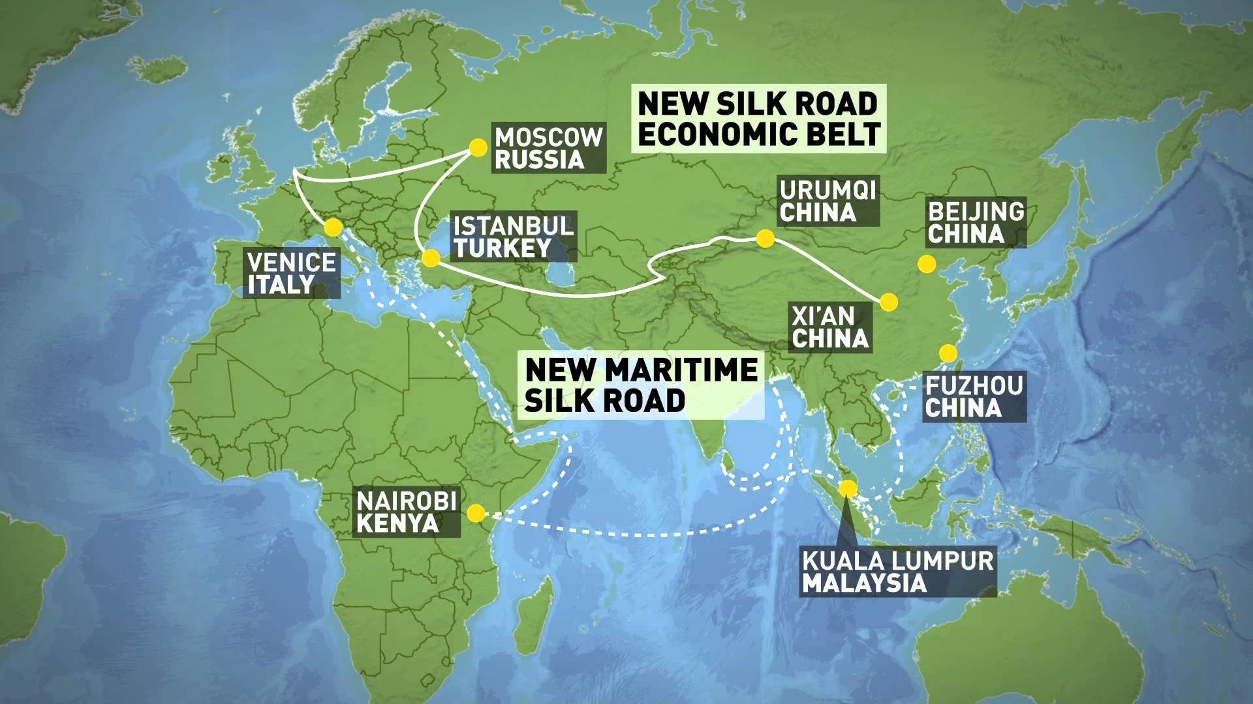

Slide 16
Current Events Update_3: United States (US)
U.S. Coast Guard plans to build six more icebreakers to replace the aging ones, though the first won't be delivered until 2023
Trump administration
Republicans vote to allow drilling in Arctic National Wildlife refuge as Senate rejects Trump tax plan amendment (conservative victory that was unprecedented since 1997 and marked a break in policy)
drafted proposal to offer offshore blocks to oil and gas drillers in almost all of the U.S. outer continental shelf and opens the door to drilling in the Atlantic and Pacific oceans

Slide 17
Current Events Update_4: Others
Greece, Mongolia, Turkey, and the European Union (EU) have applied for observer status in the Arctic Council, with the results still pending
Arctic Policy Framework is currently being drafted by the Justin Trudeau administration
April 2018: Faroe Islands is expected to hold a constitutional referendum regarding autonomy and independence from the Kingdom of Denmark
the Norwegian government is preparing to merge its two northernmost Arctic counties, Finnmark and Troms, to be completed by 2020
Oslo is hoping to accelerate oil surveys of the Barents Sea region
late 2017: talks regarding a possible rail link between Rovaniemi, Finland and Kirkenes, Norway, and potentially Russia and China commenced
the Arctic has its warmest winter on record, with up to 45 degrees above normal

Slide 18
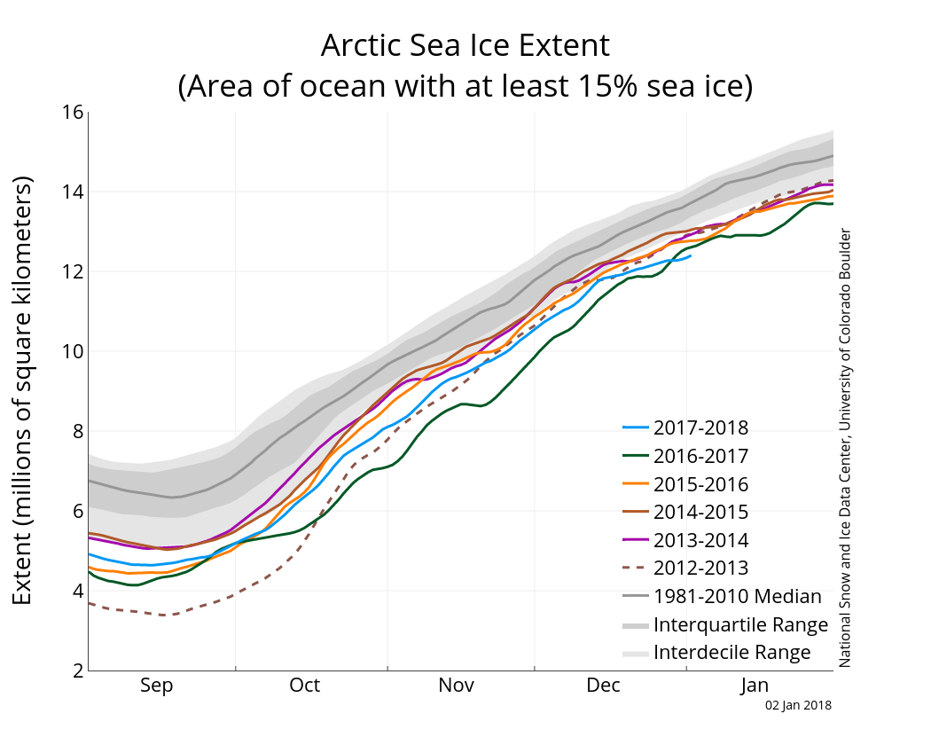

Slide 19
Countries’ Stance_1
Canada (same)
owns 40% of Arctic landmass
focuses on militarization and territorial disputes
training operations and produces new patrol vessels/warning systems
good relationships
Denmark (same)
interested in increasing military presence
non-nuclear policy
seeks to develop its uranium program in the Arctic

Slide 20
Countries’ Stance_2
Norway
“number one priority in foreign policy”
has a militarized region to combat Russian presence
promotes peace in the region and seeks to remain allies with Russia
strongly believes in the UNCLOS
Russia (changed)
Arctic region is of vital economic and strategic interest to Russia (supply-line and a geographically advantageous position
Russia is strongly in opposition to the res communis status
aggressive and with significant military presence and economic activity

Slide 21
Countries’ Stance_3
US (changed)
neither signed nor ratified the UNCLOS
has not heavily militarized the region (other priorities)
focuses on exploiting its resources
aims to operate by 2025 in the area
in support of oil drilling
China (changed)
observer in the Arctic Council
similar to Russia, the Arctic Region is of great economic interest
allied with Russia in the region
“Polar Silk Road” (above)

Slide 22
Blocs
those not directly involved/does not have access to territorial claims
those in the region that affirms the UNCLOS and promotes peace (ex: Denmark, Norway, etc.)
those with significant military presence and aggressive nature (ex: Russia, USA, China)
note that despite there being countries with similar stances, as countries have individual quarrels over territories, the situation is much more complex

Slide 23
References
https://www.cnbc.com/2018/02/06/russia-and-china-battle-us-in-race-to-control-arctic.html
https://www.cnbc.com/2018/01/26/china-unveils-vision-for-polar-silk-road-across-arctic.html
http://www.independent.co.uk/news/world/americas/arctic-alaska-republicans-national-wildlife-refuge-senate-tax-plan-polar-bears-donald-trump-a8088151.html
https://www.cnbc.com/2018/01/04/trump-aims-to-open-arctic-pacific-and-atlantic-to-offshore-drilling-in-ambitious-new-plan.html
https://overthecircle.com/2017/12/30/arctic-politics-in-2018-a-look-ahead/
https://www.theatlantic.com/science/archive/2018/02/its-54-degrees-warmer-than-normal-in-the-arctic/554303/
http://www.johnenglander.net/sea-level-rise-blog/china-russia-may-take-top-world-new-polar-silk-road-arctic-newsweek/ (picture)
http://nsidc.org/arcticseaicenews/2018/01/ (picture)

Slide 24

Addressing the degree of capital punishment for drug possession

Slide 25

Current Events Update
March 12-16: 61st session of the Commission on Narcotic Drugs (CND)
“promote efforts to stop organized crime while protecting human rights, enabling development and ensuring rights-based treatment and support” ~António Guterres, UN Secretary General
UN Secretary General Antonio Guterres calls for decriminalization of all drugs

Slide 26

Positions-Philippines
Plans to withdraw from the International Criminal Court
ICC has been examining Duterte’s War on Drugs
President Rodrigo Duterte asked governments to abandon the International Criminal Court

Slide 27

Positions-USA
On March 10, President Trump stated that he was in favor of allowing prosecutors to seek the death penalty for convicted drug dealers
Claims the US Criminal Justice System is too soft on drugs

Slide 28
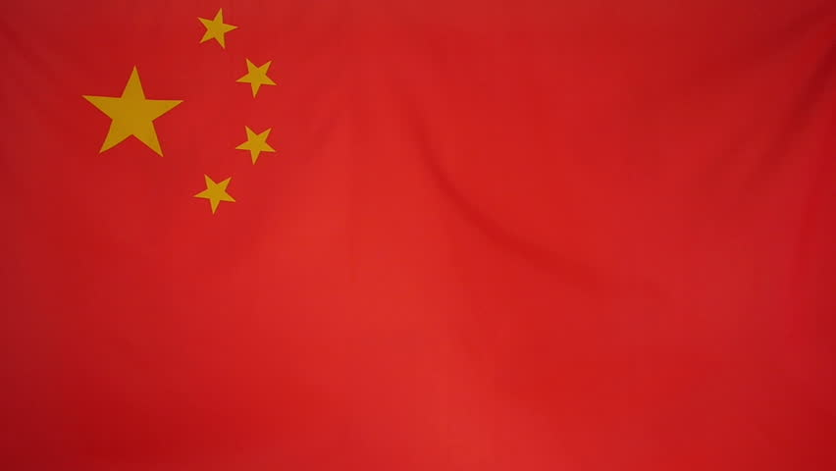
Positions- China
Currently includes death penalty in possible sentences for drug trafficking
50+ grams of heroin or crystal methamphetamine could result in the death penalty

Slide 29

Positions- France
Looking for a massive reform on drug laws
Currently has harsh laws and high drug consumption rates
Does not support decriminalization of drugs such as marijuana
Looking to introduce a flat-rate fine for drug offences

Slide 30
Blocs
Countries that use capital punishment for drug offences
Countries looking to lessen sentences for drug crime, or decriminalize drugs
Countries that have abolished the death penalty as a whole, but have a relatively strict stance on drug crime

Slide 31
References
http://www.unodc.org/unodc/en/commissions/CND/index.html
http://www.unodc.org/unodc/en/commissions/CND/session/61_Session_2018/session-61-of-the-commission-on-narcotic-drugs.html
http://www.business-standard.com/article/international/war-on-drugs-philippines-duterte-quits-international-criminal-court-118031400555_1.html
https://www.washingtonpost.com/world/asia_pacific/duterte-calls-for-abandoning-international-criminal-court/2018/03/18/f9afd9de-2a7a-11e8-a227-fd2b009466bc_story.html?utm_term=.0b34abf80b50
https://www.thenewamerican.com/usnews/constitution/item/28480-trump-wants-death-penalty-for-drug-dealers-but-is-federal-war-on-drugs-constitutional
http://www.france24.com/en/20180228-harshest-laws-highest-drug-usage-france-legalisation-cannabis-reform-laws-policy

